Slide 1

Computers Transforming Society
Improving Lives, AI and machine Learning

Slide 2
Learning Outcomes
1.11 discuss the complex relationship between computing technologies and society including issues of ethics
1.12 compare the positive and negative impacts of computing on culture and society
1.13 identify important computing developments that have taken place in the last 100 years and consider emerging trends that could shape future computing technologies
1.18recognise the diverse roles and careers that use computing technologies

Slide 3
Impacts of computer of society
The relationship between computing technologies and society is very complex
For the past 70 years computing tech. has changed society faster and more dramatically than any other development.
Many developments are positive but many have negative effects e.g. DNA matching combined with digitisation of public records has transformed our ability to research family history but can be used to find missing people or criminal suspects. This raises many ethical questions

Slide 4
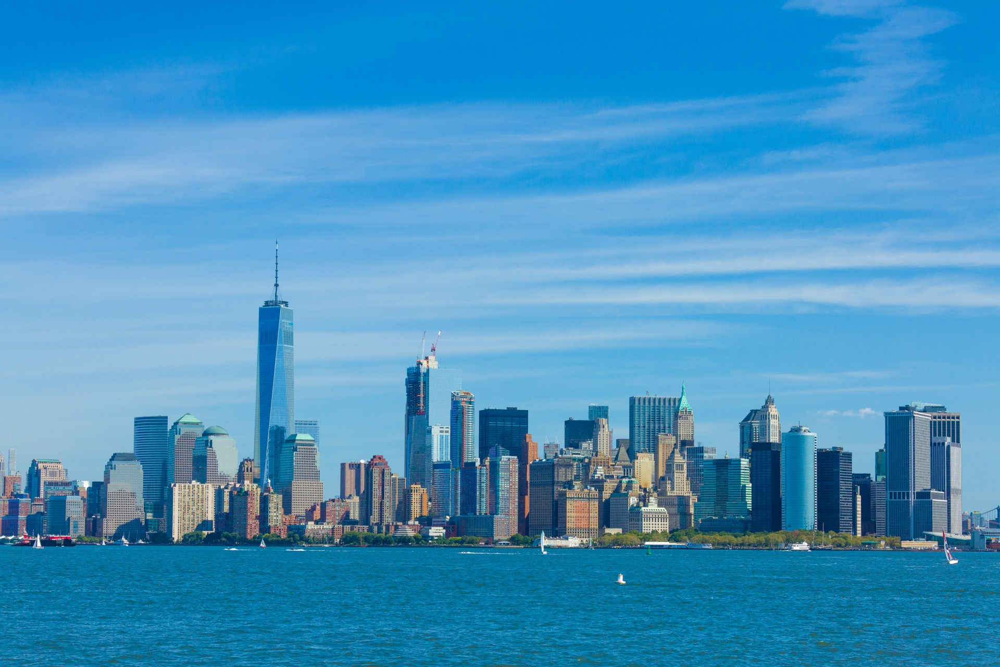
A Case Study – Travelling to New York
1950’s – Dublin to New York
Declan makes a number of phone calls to travel agents a month before he wants to travel
A few days later he visits his selected travel agent and buys his return flight to New York Via London (€6,000 in todays money). His flight is 2 weeks later than he wanted but 1 month away was too expensive

Slide 5
A Case Study – Travelling to New York
1950’s – Dublin to New York
Declan uses the Travel Agent to reserve a room in hotel in Manhattan for €1,000. This involves lots of paperwork. He chose his room based on a paragraph of text with no photos.
He pays the Travel Agent over €4,000 by cheque and still owes the travel Agent over €3,000
He borrows €3,000 from is father. Declan goes to the post office and posts the second cheque to the travel agent.

Slide 6
A Case Study – Travelling to New York
1950’s – Dublin to New York
A few days later, he phones the Travel Agent to check if the cheque had arrived.
The travel agent puts the tickets and hotel reservation documents in the post
Declan receives his tickets, etc.. 2 days before the flight.

Slide 7
A Case Study – Travelling to New York
1950’s – Dublin to New York
Day of flight, Declan makes very expensive call to friends in New York to tell them he’s on the way.
At airport , he waits in several long queues where paperwork is checked and luggage dealt with
Declan puts paper nametags on his luggage. If they fall off or his luggage get lost, it will probably be lost forever so he keeps all valuables on him.

Slide 8
A Case Study – Travelling to New York
1950’s – Dublin to New York
Declan gets his flight to London and walks around Heathrow asking people where to get the New York flight. Eventually he finds the correct gate
He arrives in New York and waits in Immigration queue to get passport checked
There’s an issue with his visa but it eventually gets sorted out

Slide 9
A Case Study – Travelling to New York
1950’s – Dublin to New York
Declan has to ask people where to pick up his luggage and eventually gets sorted
He gets his currency exchanged at a desk at the airport and it is very expensive.
He buys something at a newsagents so he has change to make a phone call to his friends to arrange to meet them the following day

Slide 10
A Case Study – Travelling to New York
1950’s – Dublin to New York
Declan realises he forgot to give an important file to his boss before he left. To sort this out he makes a very expensive phone call to his boss to explain where he left the file on his desk.
He gets a taxi to his hotel. Due to an accident blocking the road he gets out early but can’t figure out where his hotel is. He asks a passerby but they don’t understand his accent. Eventually he finds someone who can tell him where to go and he finds his hotel.

Slide 11
A Case Study – Travelling to New York
1950’s – Dublin to New York
Declan’s watch has stopped because he forgot to wind it. He considers buying one of those new battery operated ones but they’re very expensive

Slide 12
A Case Study – Travelling to New York
Today – Siobhán’s Journey
Siobhán booked her ticket the day before her flight. It was expensive as a result €600. She pays for it completely with her credit card.
Siobhán applied for her ESTA (visa to visit America) in advance but it only took a few minutes
Siobhán used the WWW to search for hotels in New York under $200 per night and finds 1,543 options

Slide 13
A Case Study – Travelling to New York
Today – Siobhán’s Journey
Siobhán uses reviews from other tourists and lots of photos of the hotel rooms to chose her hotel and room. She appreciates the photos taken by other tourists of the hotel taken only last week. She doesn’t trust the hotels own photos to show the whole story.
Siobhan uses a comparison website to find the best price for the hotel she wants to stay in and pays for it online.
Siobhán checks in for her flight online and gets her mobile boarding pass.

Slide 14
A Case Study – Travelling to New York
Today – Siobhán’s Journey
Siobhán emails her friends in New York with the details of her visit
Next morning, she uses an app to book a taxi to the airport
She brings her bags at the automated luggage drop machine where she uses her mobile boarding pass on her phone to check her luggage in and print the luggage tag. Siobhan bought a GPS bag so she can track her luggage with her phone anywhere in the world.

Slide 15
A Case Study – Travelling to New York
Today – Siobhán’s Journey
Siobhán is a computer programmer and notes that the metal detectors, body scanners and x-ray machines are all computer systems.
During takeoff, she can’t use any electronic devices.
The plane has free wi-fi so Siobhan researches what the winglets on the tip of the wings are for. These are an example of how computers have changed air travel. The winglets save fuel and their design was aided by cheap computational testing instead of expensive wind tunnel testing.

Slide 16
A Case Study – Travelling to New York
Today – Siobhán’s Journey
Siobhán is a computer programmer and notes that the metal detectors, body scanners and x-ray machines are all computer systems.
During takeoff, she can’t use any electronic devices.
The plane has free wi-fi so Siobhan researches what the winglets on the tip of the wings are for. These are an example of how computers have changed air travel. The winglets save fuel and their design was aided by cheap computational testing instead of expensive wind tunnel testing.

Slide 17
A Case Study – Travelling to New York
Today – Siobhán’s Journey
Siobhán also reads an online article about a certain type of plane that has recently being grounded due to 2 crashes in which hundreds died. These were caused by faulty flight control software.
Siobhan then watches a film on her phone
She researches where to visit and restaurants in New York and books some tickets for touristy things and makes reservations for restaurant, all using her phone and the inflight wi-fi

Slide 18
A Case Study – Travelling to New York
Today – Siobhán’s Journey
Siobhán also reads an online article about a certain type of plane that has recently being grounded due to 2 crashes in which hundreds died. These were caused by faulty flight control software.
Siobhan then watches a film on her phone
She researches where to visit and restaurants in New York and books some tickets for touristy things and makes reservations for restaurant, all using her phone and the inflight wi-fi

Slide 19
A Case Study – Travelling to New York
Today – Siobhán’s Journey
Siobhán realises she forgot to send an important file to her boss, She logs in to her companies computer system, finds the file and emails it to him.
She messages her friends using her phone to tell them her plans for the next few days and messages her parents to tell them she made her flight and is nearly there.

Slide 20
A Case Study – Travelling to New York
Today – Siobhán’s Journey
Thanks to her electronic visa and the e-gates in New York airport, Siobhan flys through immigration and her phone confirms her bag has arrived.
She doesn’t need to look at the information screens for details of where to pick up her bag as her phone tells her where to go
She doesn’t need to exchange currency as she will use her credit card that does it automatically

Slide 21
A Case Study – Travelling to New York
Today – Siobhán’s Journey
She checks her phone to find the quickest way to her hotel and this tells her what subway to use and where to change trams.
She pays for the subway using her phone that she holds up to the scanner at the barrier.
Once out of the Subway, she uses the map app on her phone to find her hotel and walks there

Slide 22
A Case Study – Travelling to New York
Today – Siobhán’s Journey
Siobhan’s phone and watch automatically change the time zone when she arrived in New York so she can tell the local time easily

Slide 23
Computer science is changing everything : https://www.youtube.com/watch?v=QvyTEx1wyOY

Slide 24
Impacts of Computers on society
It’s impossible to think of one facet of modern lives that computers haven’t affected – normally, but not always, for the better
It is very difficult to avoid using the Internet. More and more the internet is built into our everyday experiences. The internet is expected to play an even greater part in our day to day lives

Slide 25
Medicine and Healthcare
Computing technology has greatly improved medicine and healthcare.
Much of modern medicine still depends on people, which carries a risk of human error. Often a diagnosis is based on the interpretation of information by a single person – and people make mistakes.
https://www.youtube.com/watch?v=V680nMGpeEM&t=8s

Slide 26
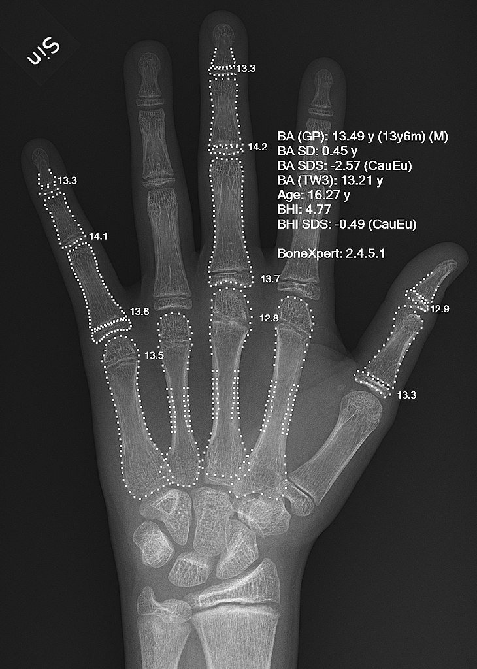
Medicine and Healthcare
Computing is transforming medicine by assisting medical professionals to make a diagnosis.

Slide 27
Medicine and Healthcare – Image recognition and classification algorithms
Image recognition and classification algorithms are already being used to identify cancerous tumours in medical imaging.
This was done up to recently solely by people, but now with assistance from computers the chances of errors occurring can be greatly reduced.

Slide 28
Medicine and Healthcare – Image recognition and classification algorithms
The computer pre-process the images and identify potentially cancerous tumours. A human expert can then pay extra attention to these images
The computer can also post-process images that were already checked by an expert to ensure nothing was missed.

Slide 29
Medicine and Healthcare – Clinical Decision Support Systems
In Ireland, the GP, plays a central role in the healthcare system and is normally the 1st person seek medical advice
Some GPs are already using computers to help them do their work better. One specific area that’s in a rapid state of change is clinical decision systems

Slide 30
Medicine and Healthcare – Clinical Decision Support Systems
A clinical decision support system provides doctors with assistance in making medical decisions.
The system can be knowledge based. The system uses information from medical literature and expert knowledge
The system can be based on artificial intelligence.

Slide 31
Medicine and Healthcare – Clinical Decision Support Systems – An example
Patient presents with a fever, headache and a rash on the stomach
Traditionally the doctor must rely on their experience and knowledge (both of which may be biased and based on limited number of cases) to guide their diagnosis
A Clinical Support System instantly draws upon symptoms and diagnosis from thousands of cases and factor them into the diagnosis

Slide 32
Medicine and Healthcare – Clinical Decision Support Systems – An example
Other not readily accessible information can be used with these systems e.g The system may prompt the doctor to ask if the patient travelled abroad recently as these 3 symptoms are common to a rare disease in some distant country
The doctor may not have come across this disease before. Without the clinical support system, the doctor may not have considered this possibility

Slide 33
Medicine and Healthcare – Genomics
A field of molecular biology that focuses on genomes, a complete set of an organisms DNA
Several thousand genetic diseases affect humans and are 1 of the main causes of infant deaths. (Downs Syndrome, Fragile X syndrome..) Identifying which genetic disease is affecting a critically ill child is very difficult and often time is of the essence

Slide 34
Medicine and Healthcare – Genomics - Example
The Center for Pediatric Genomic Medicine in the US reported a baby suffering from liver failure for an unknown reason. The hospital used 25 hours of supercomputer time to analyse 120 Billion DNA sequences, narrowing down the cause of the illnss to two possibilities. This allowed the doctors to save the baby’s life. Without advanced computing technology the baby would have died.

Slide 35
Medicine and Healthcare – Genomics – Screening for genetic markers
Scientists have identified genetic markers that can indicate a predisposition to certain diseases, including several types of cancer.
Screening for some inherited and other genetic diseases is now common

Slide 36
Medicine and Healthcare – Genomics – Screening for genetic markers
Cystic fibrosis, and Huntingdon’s disease are caused by genetic mutations. Genetic markers for these and many other diseases are currently being researched using rapidly developing technologies.

Slide 37
Medicine and Healthcare – Genomics – Alteration of Genetic Code
It’s technically possible to analyse and alter genetic code of humans, even before birth, to achieve many goals such as avoid some diseases.
Technical, LEGAL and ETHICAL issues must be overcome for these practices to become mainstream.

Slide 38
Medicine and Healthcare – Genomics – Alteration of Genetic Code
The ability to alter genetic code means that people could potentially chose non-life threatening attributes influenced by genetics for their children (eye colour, predisposition for baldness or weight gain etc..)
Genetic editing of human embryos is illegal or restricted in most countries. This area is fraught with ethical concerns and require legal, governmental and societal oversight

Slide 39
Tasks -
Computer Science Book pg 281 Task 4
Research some potential future changes in genomics that computing technology many bring about.
Computer Science book pg 293 Task 10.

Slide 40
Encryption and Privacy
Encryption refers to the use of algorithms to securely encode a message into a ciphertext.
The recipients have the means to decode the ciphertext back into plaintext
Encryption allows anyone with a computer and special software to encode messages and information

Slide 41
Encryption and Privacy
It is becoming more common for web pages to use hypertext transfer protocol secure (https). The visitor to a website using https can be relatively sure they are communicating directly with the intended website. They can be reasonably confident that any information between their computer and the websiteis safe, even if it is intercepted by a malicious actor.

Slide 42
Encryption and Privacy
Many popular messaging and social media apps also use encryption to ensure that message sent from one user to another are not readable by anyone who intercepts them
Similarly, industrial and military communications are often encrypted
Many businesses use software on their computers/devices that encrypt all stored data so that if a laptop is stolen, the data can not be accessed without the correct password

Slide 43
Encryption and Privacy
These encryptions do not just protect the data with a password but all data is also encrypted (unreadable/scrambled). The password lets the user in but also unscrambles the data so that it makes sense

Slide 44
Encryption and the economy
Encryption is also the basis of much of the world’s economy. Online banking and many other transactions rely on some form of encryption

Slide 45
Encryption and the economy: Currency
Bitcoin became a household name around 2018. It is one form of cryptocurrency.
Cryptocurrency is any form of currency that exists digitally or virtually (not in physical form) and uses cryptography to secure transactions.

Slide 46
Encryption and the economy: Currency
Some advantages of digital currencies compared to physical currency (coins, paper banknotes etc..) include instant transfer, traceability and protection from traditional theft and loss.
Bitcoin is just one of thousands of types of currency.
Cryptocurrency uses decentralized control which means no one person or bank or government can control the transactions or create new units of currency.

Slide 47
Encryption and the economy: Currency
The adoption of digital currency has been relatively slow. It is likely that society will continue to move towards digital currencies and away from current systems largely based on fiat currencies where the value is often enforced by a centralised authority.
A weakness of fiat currencies is that its dependent on a centralised authority such as a government and in difficult times such as war, the currency can experience wild fluctuations in value.

Slide 48
Encryption and the economy: Currency
Another weakness of fiat currencies is they require large banking systems to facilitate safekeeping, exchange and other services. This makes the use of fiat currencies expensive in comparison to digital currencies.
https://www.investopedia.com/terms/c/cryptocurrency.asp

Slide 49
Jobs
Computers have created thousands of job types and millions of individual jobs that a few decades ago, did not exist. Many of these jobs are directly concerned with computing technologies including:
Computer programmers
IT managers
Web designers
Social Media celebrities

Slide 50
Jobs
A large number of jobs have also been indirectly created by computing. e.g. the rise in online shopping has led to a massive increase in parcel shipments creating many new jobs in warehousing and distribution
Many jobs have been lost due to changes in technology. Jobs that require routine , repetitive and dangerous tasks such as assembly line work and working with hazardous materials have been eliminated and replaced with automated processes and and robotic solutions

Slide 51
Jobs
Retail jobs have been lost due to online shopping
Travel agents have been disrupted by the internet and e-commerce

Slide 52
Remote Working
During the pandemic many peoples jobs were saved because of technology. Technology allowed people to carry out their jobds remotely
Shifting to remote working provides flexibility and can preserve jobs but it highlights the importance of everyone having access to high speed broadband.
Remote working can also revitalise rural towns that were struggling to survive pre-pandemic
Remote working also benefits the environment as there is less commuting

Slide 53
The Environment
Computing has many substantial direct effects on the environment
Nuclear Weapons Testing using supercomputers One of the most common uses of supercomputers is to accurately test and model the effects of nuclear weapons. Prior to supercomputers, live tests were the only viable option. Live nuclear tests, resulted in destructions of many areas of Earth; the production of tons of nuclear waste; the health of millions of people were affected by these nuclear tests and the displacement of many minorities and marginalised groups of people.

Slide 54
The Environment
Computing has many substantial direct effects on the environment
Energy Consumption and reduction :Power consumption has become one of the largest issues of computing technology. Cryptocurrency mining uses more energy than the entire country of Ireland.
Computers enable some processes to be more energy efficient through better control and analysis. E.g. modern electric cards would not be possible without the software that controls them. Electric cars produce fewer emissions and are more energy efficient than traditional cars.

Slide 55
Image and facial recognition
There has been a rapid increase in the accuracy and proliferation of image and facial recognition in recent years
The ability to scan vehicle number plates is used for many purposes: controlling access to carparks; enforcing toll payments ;identifying car owners with outstanding arrest warrants.
Facial recognition systems are now used to: scan airport passengers; provide access to mobile phones; match photos of similar people / family on social media platforms

Slide 56
Image and facial recognition
In China, it is now common to pay for goods just by looking at the camera at the til.
Image recognition and classification are used to detect skin cancers and scan people’s retinas (for biometric security/identification as well as disease
https://www.youtube.com/watch?v=YX8BzK_LU0E

Slide 57
Education – Online Learning
There are vast quantities of online courses, instructional videos and distance and blended learning where students can study almost any subjects, at university level and lower, without leaving the comfort of their own home.
It is common to submit homework online. Many top universities such as Havard, MIT and Standford deliver Massive Online Open Courses (MOOC) with thousands of students . They are mainly free and available worldwide

Slide 58
Linguistics and Communication
Speech Interpretation The main barrier to this was a lack of algorithms that could effectively, quickly and accurately interpret human speech. Human speech is extremely vague and confusing. - - There are many different ways to say the same thing.
Words that sound exactly the same, can have different meanings e.g rain, reign, reins, reindeer; two, to, too,

Slide 59
Linguistics and Communication
Speech Interpretation As humans we are very good at interpreting the meanings but it is extremely difficult to write programs to correctly interpret speech. Recently, algorithms have been developed, and computers can now interpret speech quite accurately
https://www.youtube.com/watch?v=6altVgTOf9s

Slide 60
Linguistics and Communication
Automatic Translation
One way that computing has affected linguistics is by automatically translating from one language to another. It is now possible to have software on your phone that can translate between dozens of natural languages in real time. This was only in its infancy a few years ago but it has opened up new travel and international business opportunities for millions of people.

Slide 61
Art & Entertainment
Art & entertainment has been radically impacted by computer technology.
Animated feature films are now entirely dependent on cutting edge technology to produce their content. Animated films are now COMPLETELY generated by computers. Some of the scenes are so complex that high performance computing software is required to render the images. These films use tens of thousands of computer processors and hundreds of millions of CPU hours. If only a single computer was available, it would take tens of thousands of years to make a single film.

Slide 62
Developing Societies, human rights and Equality
One of the greatest promises of computing technology lies in the help it may be able to give developing world. Technology may be able to locate resources such as drinking water, healthcare and education
Digital Divide Computing technology may lead to greater inequality by increasing the gap between those that have easy and affordable access to computers and the internet and those who do not.
The internet is reshaping our definition of human rights. Should access to the internet be a human right??

Slide 63
Developing Societies, human rights and Equality
The internet is reshaping our definition of human rights. Should access to the internet be a human right?? Access to the internet can: Affect freedom of speech; enable social mobility; provide the ability to earn an income; facilitate learning about potentially life-threatening matters; provide free access to medical information.

Slide 64
Developing Societies, human rights and Equality
Internet access depends on socio-economic status, geographical location, political environment and the local laws.
In 1999, only 0.04% of the world had internet access. In 2014 it had increased to 40% and by 2020 it was almost 60%
But the ability to access the internet is not the same from country to country

Slide 65
Media and social media
The internet and social media can be used to influence people. Fake news can spread easily and quickly and can affect decisions such as :
Selecting which product to chose
Making important health decisions
Determining who to vote for in political elections.

Slide 66
Media and social media
Deep fakes are material that artificial intelligence produces to provide fraudulent but credible looking photos, audio clips and video clips. Deep fakes proliferate the internet and have the capacity to misinform and mislead millions.
https://www.youtube.com/watch?v=gLoI9hAX9dw

Slide 67
Some questions to answer
Pg 293 Q15 – How might people in the developing world be empowered by computing technology
Pg 293 Q18 Find one positive and one negative effect computing technology can have on democratic elections.
Pg 293 Q20 What could the use of cyber warfare involve, if used in future conflicts.

Slide 68
Artificial Intelligence / Machine Learning
Artificial Intelligence refers to using computer systems to perform tasks that normally require human intelligence
Machine Learning gives computers the ability to learn without being explicitly programmed
What is Artificial Intelligence
https://www.youtube.com/watch?v=aOP2eJWehwo&list=PLIP_AClgjRDgDqmMD5qRhrqAzVLUaeixm&index=2

Slide 69
Machine Learning
https://www.youtube.com/watch?v=ETfWKZIu-sk
Cheatsheet -> https://bit.ly/32qdLPH

